Slide 1
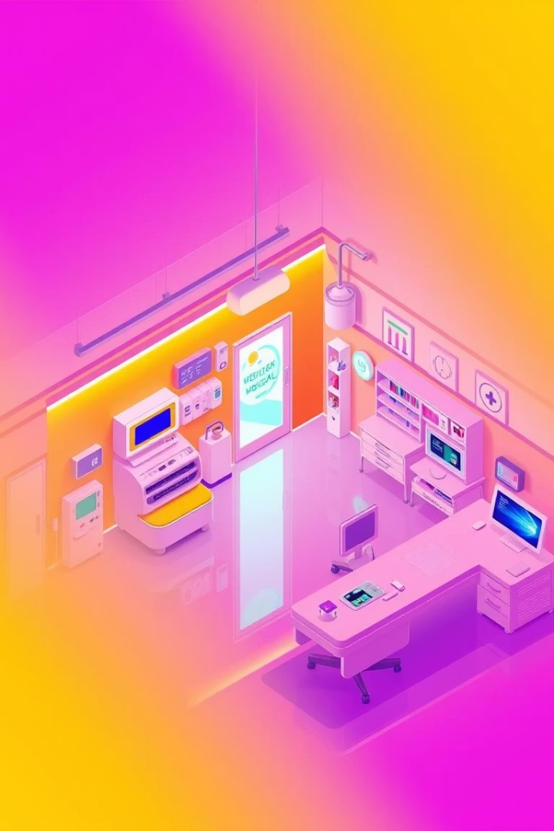
HealthMate: AI-Powered Health Companion
Early Diagnosis. Trusted Doctors. Digital Health Locker.

Slide 2

Real-World Impact
Skipped Checkups
Nearly 20% of Indians have skipped essential medical treatments due to financial constraints.
36% of insured individuals reduced doctor visits because of high out-of-pocket expenses.
Repeated Tests
Patients forget 40–80% of medical information provided by healthcare
practitioners immediately after consultation.
Lack of centralized electronic health records in India leads to challenges
in accessing past medical information, resulting in repeated tests and
increased healthcare costs.
Rural Delays and unaware of right doc’s
People often don’t know which doctor to consult for what disease and the
process to find one is too long.
And we don’t really know the feedback of any doctor’s so we have trust them blindly

Slide 3
Millions Delay Treatment
The Problem
The Impact
Ignore symptoms
Late diagnoses
Don't know specialist
Increased costs
Lose reports
Broken continuity

Slide 4




Our Vision: Accessible Healthcare
Instant checkup
Right doctor
Anywhere Access
Seconds to check symptoms
Guided to the right doctor
Medical history accessible

Slide 5




Three-Part AI Solution
Symptom Diagnosis
AI predicts diseases
Doctor Recommendations
Smart specialist match
Digital Health Locker
Secure report storage

Slide 6
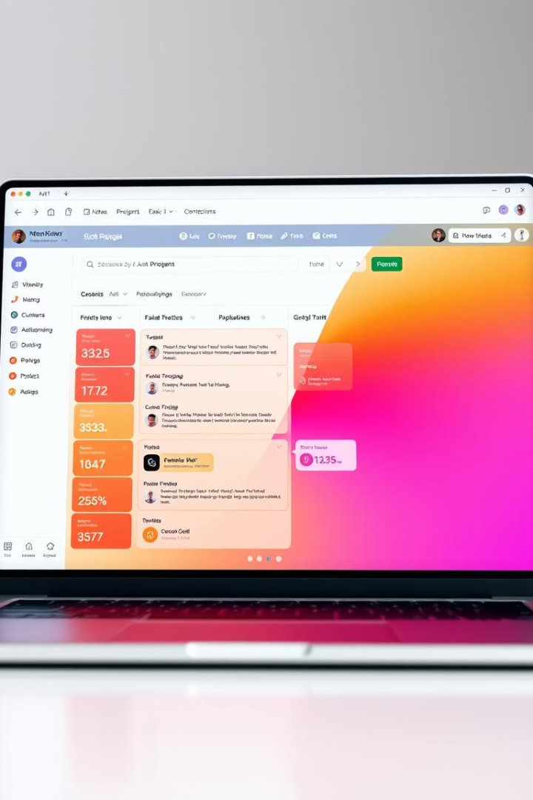
Execution Roadmap
1
Ideation & Planning
Features & flow defined
2
Core Development
ML, backend, frontend
3
Integration & Testing
APIs to frontend
4
Demo-Ready Build
Polish & validations

Slide 7

Tech Stack
Component
Tech
Detection
Python, Scikit-learn, Flask
Suggestion
Custom ML Model (Flask)
Locker
Supabase (auth + storage)
Frontend
Tailwind + Template
Backend
Node.js + Express + MongoDB

Slide 8



Beyond the Hackathon
1
Telemedicine
2
API for Hospitals
3
Mobile Health Passport

Slide 9
Thank You

